Slide 1
All about: Startups

Slide 2

What Is a Startup?

Slide 3
Understanding Startups

Slide 4

About Dotcom
A dotcom, or dot-com, is a company that conducts business through its website. A dotcom company embraces the internet as the key component in its business.
Dotcoms are so named because of the URL customers type to visit the website to do business with the company. The .com at the end of the URL stands for commercial.
The largest number of startups in the last 20 years have been dotcoms.

Slide 5
About Bubble
A bubble is a rapid escalation of asset prices followed by a contraction, often created by a surge in asset prices that is fundamentally unwarranted.
Changes in investor behavior are the primary causes of bubbles that form in economies, securities, stock markets, and business sectors.

Slide 6
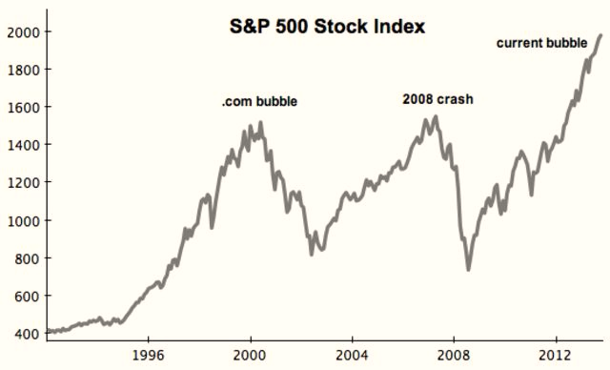
The Five Steps of a Bubble
Displacement: (new product or technology)
Boom: (Prices start to rise at first)
Euphoria: (asset prices skyrocket)
Profit taking
Panic: (asset prices change course)

Slide 7

Market research
Market research helps determine the demand for a product or service.
A startup requires a comprehensive business plan outlining mission statement, future visions, and goals as well as management and marketing strategies.

Slide 8
Special Considerations

Slide 9

Location - online, in an office/home office or store?

Slide 10
Funding
A startup is often financed by the founders until the business gets off the ground, and the startup attracts outside investment.
There are many different ways to fund startups.
A startup is simply a business in the initial business stage.
A startup may be funded using credit.

Slide 11
Crowdfunding
Crowdfunding is the use of small amounts of capital from a large number of individuals to finance a new business venture.
Restrictions apply to who is allowed to fund a new business and how much they are allowed to contribute.
Crowdfunding allows investors to select from hundreds of projects and invest as little as $10.
Crowdfunding sites generate revenue from a percentage of the funds raised.
The SEC regulates equity-based crowdfunding ventures in the United States.

Slide 12

Legal Structure- about Partnerships

Slide 13
Thanks for your attention

